Slide 1


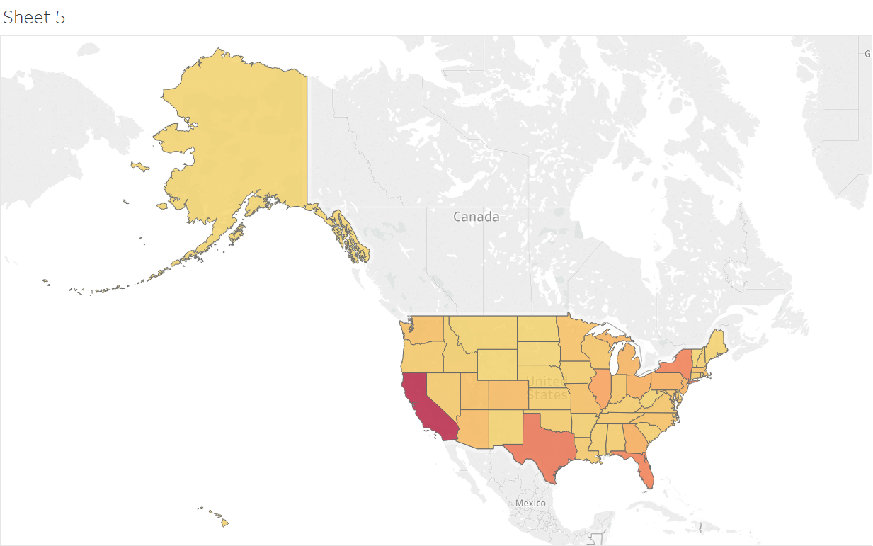
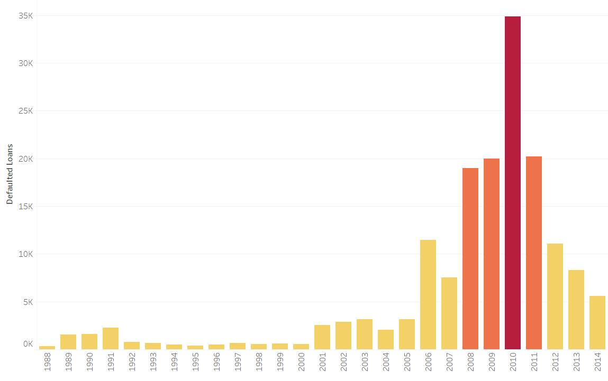
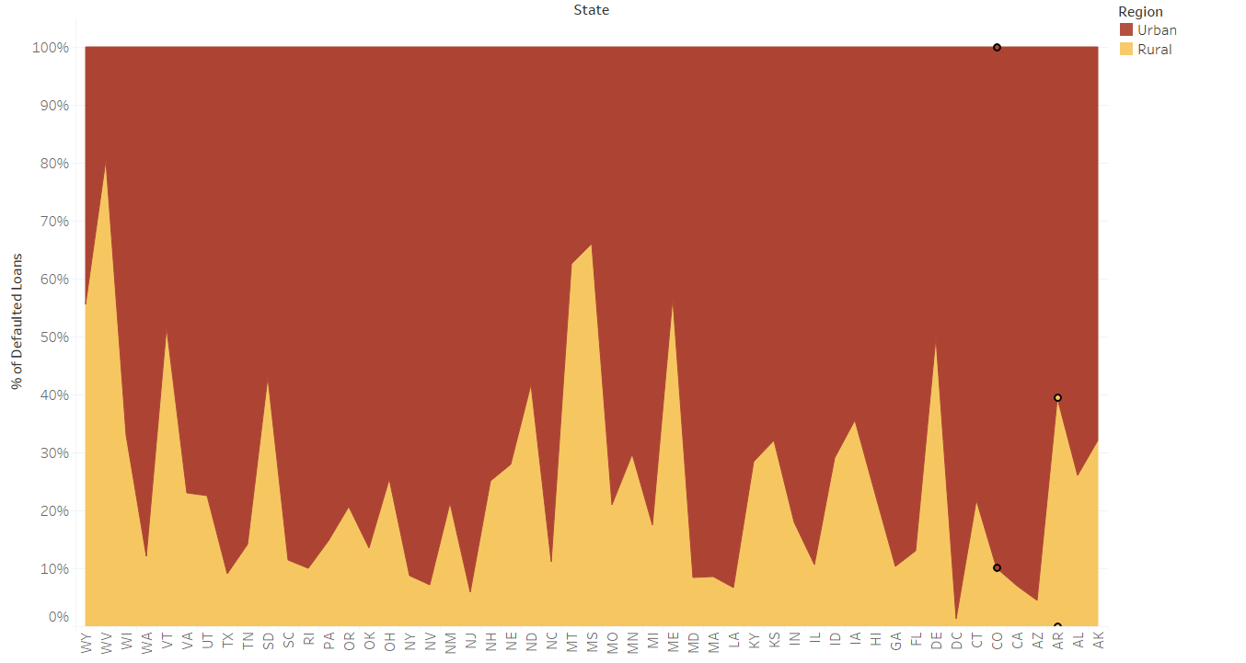
SBA LOAN DATA ANALYSIS - Vedika Shenoy
PROBLEM AND OBJECTIVE
The SBA (Small Business Administration) helps small businesses by providing them guarantees for bank loans. If a company is unable to pay the loan to the bank, SBA covers the guaranteed amount and the rest of the loss is suffered by the bank. In order to determine if a loan is prone to being defaulted, exploratory and predictive data analysis can be effectively utilized.
The SBA loan data provides various metrics such as the bank details and company details such as their size, location, type of loan and amount along with the duration of the loan. If the loan is defaulted, the date on which it has been checked off is specified.
PREDICTIVE ANALYSIS
The following two predictive models were developed using Python for analyzing the SBA loan data:
Decision Tree Classification model
Random Forest Classification model
FINDINGS
The number of defaulted loans were the highest in the years 2008 to 2011, which was a result of the housing bubble crisis. From 2012 onwards, the rate of loan default went down to what it was before 2008.
In every state in the USA, the loan defaults were larger in urban areas compared to the rural areas.
California has the highest number of loan defaults followed by Texas and New York.
IMPACT
By using data cleaning and feature engineering techniques along with machine learning models, we can predict if a loan will default in the future.
This will help SBA as well as the banks in assessing the risks associated with providing loans to the small businesses.

